Slide 1
Zephyr Workshop – Threads & Workqueues
Intro to threading model in Zephyr
Using system workqueues for deferred execution

Slide 2
What is a Thread in Zephyr?
Basic unit of execution in Zephyr
Each thread has: stack, priority, entry point
Can be preemptive or cooperative
Used for independent, long-running tasks

Slide 3
Thread API Concepts
k_thread_create(): create a thread at runtime
k_thread_define(): define a static thread
k_sleep(): pause thread execution
Priority determines order of execution

Slide 4
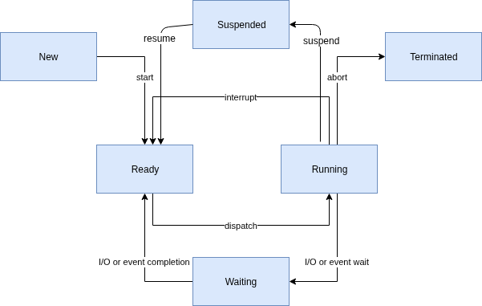
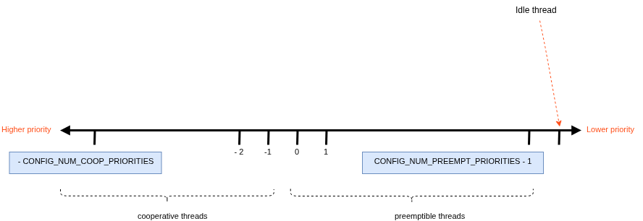

Slide 5
Basic Synchronization Demo
west build -b qemu_x86 samples/synchronization
west build -t run
*using QEMU running on your PC

Slide 6
What is a Workqueue?
A kernel object that uses a dedicated thread to process work items in a FIFO manner
Mechanism for deferring small tasks
Lightweight compared to threads
Avoids context switching overhead

Slide 7
Workqueue API Concepts
k_work: one-time deferred task
k_work_delayable: scheduled for later
k_work_submit(): submit to system workqueue
k_work_init(): set handler function

Slide 8
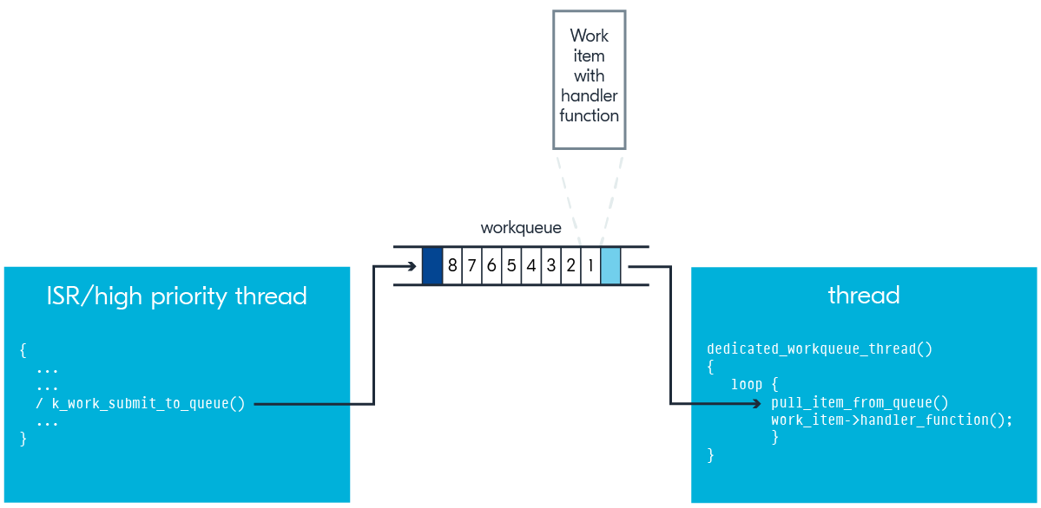

Slide 9
When to Use Threads
Long-running background operations
Independent state machines
Polling or waiting logic

Slide 10
When to Use Workqueues
Short tasks triggered by interrupt or events
Sensor readout, message dispatch, flash write
Non-blocking, quick jobs

Slide 11
Wrap-Up & Q&A
Threads = full control, more overhead
Workqueues = low-overhead, short tasks
Use both depending on timing and complexity

